Slide 1
Mobile Development :
6 : Flutter for Mobile Development : Part 1 Dart, Flutter, Widget, Basic Interactivity
Professor Imed Bouchrika National School of Artificial Intelligence imed.bouchrika@ensia.edu.dz

Slide 2
Outline :
Section 1:
Introduction to Flutter
Dart Language
Hello World ! in Flutter
Flutter Project Structure
Widgets for Building UIs
Stateless and Stateful Widgets
Section 2 :
Incrementer App
To-Do App (No DB)

Slide 3
Section 1
Introduction to Flutter

Slide 4

Introduction to Flutter
What’s Flutter
Flutter is an open-source software development framework which uses the Dart Programming language
It is designed to build natively compiled applications for mobile ( Both android and iOS), web, and desktop from a single codebase.
Flutter was first released in 2017 by Google. It has gained significant popularity in the developer community due to its versatility and ease of use.

Slide 5
Introduction to Flutter
Why use Flutter instead of Kotlin/Java
Single Codebase for Multiplatforms
High Performance due to compiling to native code
Fast Development with hot reload where changes can be applied “instantly” to running apps without losing data or states.
Support for Material design (Android theme) and Cupertino (iOS)
Beautiful Interfaces and Rich Library of Widgets
Cross-Platform Development where you can develop on various platforms for various platforms including desktop or even web and potentially backends.
Backed and Supported by Google with Strong Community Support

Slide 6






Introduction to Flutter
Popular Apps using made using Flutter
Google Classroom
Google Pay
eBay
PUBG Mobile
Toyota App
Crédit Agricole
Including apps by ByteDance, Tencent…

Slide 7
Dart Language
Dart as a Programming Language
Client-optimized, object-oriented programming for creating apps quickly for many platforms including Android, iOS, Linux, Windows and the web.
Developed by Google in 2011 to replace JavaScript, but without success.
Later, It gained huge popularity because it is the main language for Flutter
Statically typed language where data types of variables must be specified either explicitly or implicitly through inference.
Supports modern programming features as null safety checks and asynchronous prog.
Lastly, it is free and open-source + Rich standard library.

Slide 8
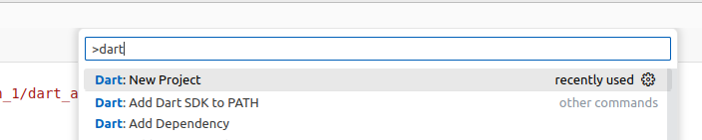
Dart Language
Getting Started with Dart
You can start to learn and test dart online at :
https://dartpad.dev/?
Install VS + Android SDK + Dart + Flutter on your Machine
To create new Project, Either :
Ctrl + Shift + P and type “dart” → Choose Dart: New Project
Choose Console App
From Console:
dart create project_name

Slide 9
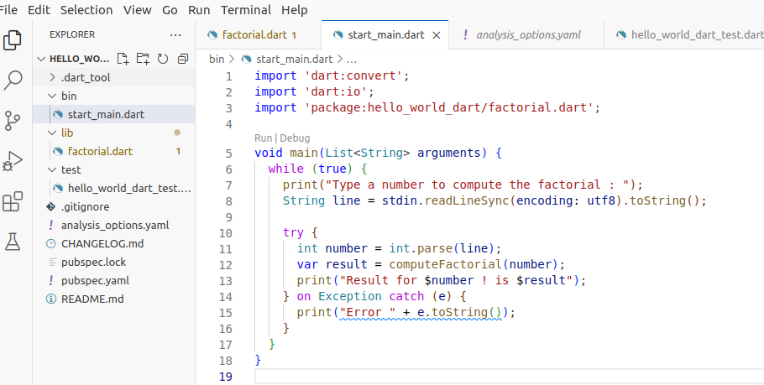
Dart Language
Hello World in Dart

Slide 10
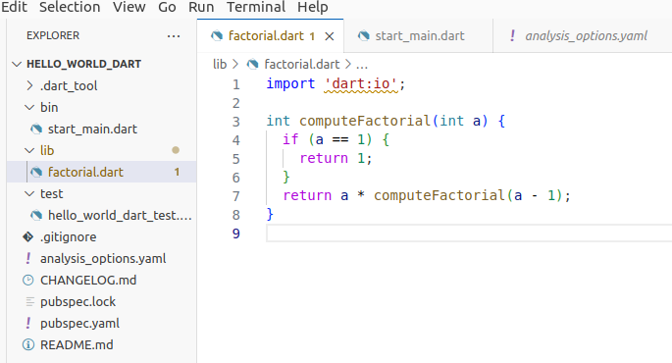
Dart Language
Hello World in Dart

Slide 11
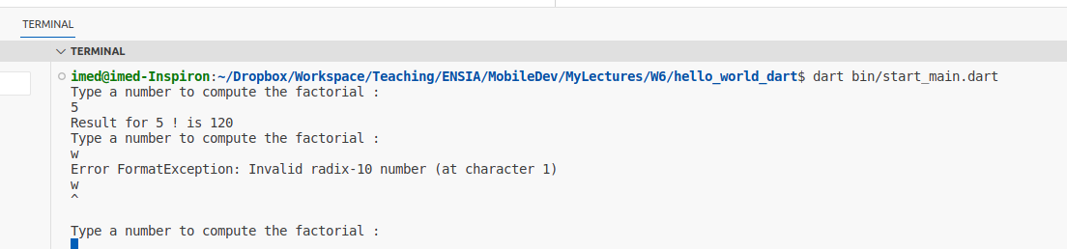
Dart Language
Hello World in Dart
Usually, you can hit the Run button to execute, but prefer to use the console with the command :
dart run OR dart bin/start_main.dart

Slide 12
Dart Language
var myName = "Imed";
String sonName;
String DaughterName = "Amel";
int age, size = 0, volume = 1; // Not recommended
bool isHappy = true;
const double pi = 3.14;
num quantity = 2.1;
Syntax of Dart : Variables
Declaring a variable can be set as
Type name = value ; :
num is to refer to both int and double
var can used to say any type
Can we assign a var to int and later string ?
Const to create immutable variables (unchangeable)
Naming convention : lowerCamelCase

Slide 13
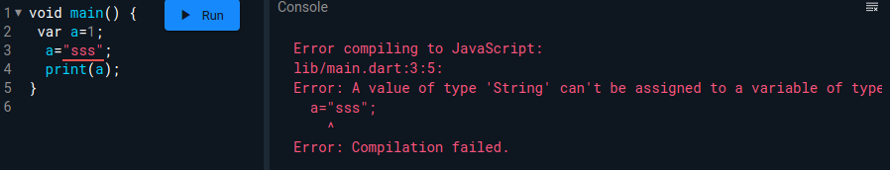
Dart Language
var myName = "Imed";
String sonName;
String DaughterName = "Amel";
int age, size = 0, volume = 1; // Not recommended
bool isHappy = true;
const double pi = 3.14;
num quantity = 2.1;
Syntax of Dart : Variables
Declaring a variable can be set as
Type name = value ; :
num is to refer to both int and double
var can used to say any type
Can we assign a var to int and later string ?
Const to create immutable variables (unchangeable)
Naming convention : lowerCamelCase

Slide 14
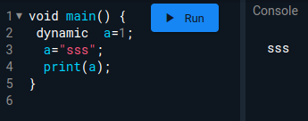
Dart Language
var myName = "Imed";
String sonName;
String DaughterName = "Amel";
int age, size = 0, volume = 1; // Not recommended
bool isHappy = true;
const double pi = 3.14;
num quantity = 2.1;
Syntax of Dart : Variables
Declaring a variable can be set as
Type name = value ; :
num is to refer to both int and double
var can used to say any type
Can we assign a var to int and later string ?
IF you are forced to use dynamically typed variables ( which is not recommended), you can use :
dynamic a=1 ;

Slide 15
Dart Language
Syntax of Dart : Data Types and Converting
String
You can use the $ sign inside a string for injecting variables into a string.
print(“Hello $name, my age is $age”)
You can use “”” to create a multi-line string”””
String to int : int myAge=int.parse(strValue)
int to String : String ageStr = myAge.toString()
String to doube : double myWeight=double.parse(strValue)

Slide 16
Dart Language
[ ]
Syntax of Dart : Collections : List
List are like Arrays in Java defined as :
Growable List : List<int> ages= [10, 21 ,31]
Fixed Length List : var ages=List<int>.filled(5,1) // Fills default val of 1
Accessing :
ages[INDEX]
Or even get inversely the index by using : ages.indexOf(31)
Methods
Ages.length : to get the number of elements in the list

Slide 17
Dart Language
[ ]
Syntax of Dart : Collections : List
Methods
ages.length : to get the number of elements in the list
add (item ) : to add an element
insert(index, item) : to add a specified index and shifting other elements
remove(item) : remove an item by value (only one item removed at a time)
removeAt(index) : remove element at a given index.
Properties of the List:
first , last, isEmpty , isNotEmpty, reversed, single
Combining two list using spread syntax
var bigList =[...listOne, …listTwo] ;

Slide 18
Dart Language
{ }
Syntax of Dart : Collections : Set
Set is a unique collection of items. No duplicates ( in contrast to a list)
Set<String> fruits = {"Apple", "Orange", "Mango"};
fruits.add("Grapes");
fruits.remove("Orange");
String firstElement = fruits.elementAt(0);
bool hasMango = fruits.contains("Mango");
int fruitsCount = fruits.length ;

Slide 19
Dart Language
{key:val }
Syntax of Dart : Collections : Map
Map<String, String> countryCapital = {
'USA': 'Nothing',
'India': 'New Delhi',
'China': 'Beijing'
};
countryCapital['Algeria'] = 'Algiers';
bool checkOne = countryCapital.containsKey("India");
bool checkTwo = countryCapital.containsValue("India");
print("All keys of Map: ${countryCapital.keys}");
print("All values of Map: ${countryCapital.values}");
print("Is Map empty: ${countryCapital.isEmpty}");
print("Is Map not empty: ${countryCapital.isNotEmpty}");
print("Length of map is: ${countryCapital.length}");

Slide 20
Dart Language
Syntax of Dart : Operations
Arithmetic Operators:
% Modulus
~/ Integer division ( Divide two numbers and give output as int)
Logical Operators
&& and
|| or
! not
Type Test Operators
is ( myValue is int )
is! ( myValue is! String )

Slide 21
Dart Language
Syntax of Dart : Flow Control : IF-ELSE + SWITCH
.
var dayOfWeek = 5;
switch (dayOfWeek) {
case 1:{
print("Day is Sunday.");
break;
}
case 2:{
print("Day is Monday.");
break;
}
Default:{
print("Invalid Weekday.");
break;
}
}
var noOfMonth=1;
if (noOfMonth == 1) {
print("The month is jan");
} else if (noOfMonth == 2) {
print("The month is feb");
} else {
print("Invalid option given.");
}

Slide 22
Dart Language
Syntax of Dart : Flow Control : For + While
.
for (int i = 1; i <= 10; i++) {
print(i);
}
int i = 1 ;
while (i <= 10) {
print(i); i=i+1 ;
}
List<int> numbers = [1,2,3,4,5];
int total = 0;
numbers.forEach( (num)=>total= total+ num);
List<int> numbers = [1,2,3,4,5];
for (int a in numbers){
print(a);
}

Slide 23
Dart Language
Syntax of Dart : Functions
//function to add
int add(int a, int b) {
var total;
total = a + b;
return total;
}

Slide 24
Dart Language
Syntax of Dart : Asynchronous Programming
Asynchronous Programming is a way of writing code that allows a program to do multiple tasks at the same time.
Future represents a value that is not yet available and may be available later.
async : is employed to define a function that can perform asynchronous operations .
await : is used within async’s body to pause execution while waiting for the operations to be completed.

Slide 25
Dart Language
void main() {
print("Starting");
getData();
print("End.");
}
void getData() async{
String data = await processLongRequest();
print(data);
}
Future<String> processLongRequest(){
return Future.delayed( Duration(seconds:5) , ()=> "Getting Data");
}
Syntax of Dart : Asynchronous Programming
Asynchronous Programming is a way of writing code that allows a program to do multiple tasks at the same time.
Future represents a value that is not yet available and may be available later.

Slide 26
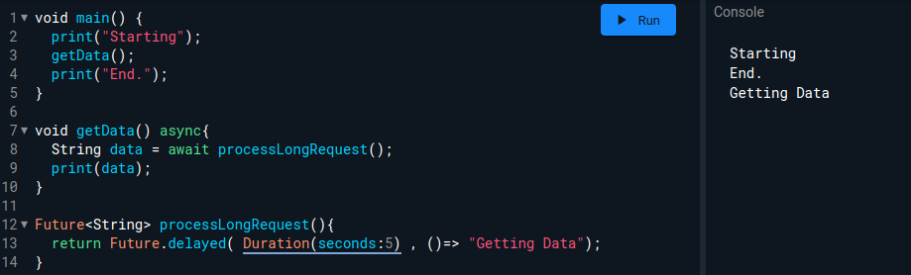
Dart Language
void main() {
print("Starting");
getData();
print("End.");
}
void getData() async{
String data = await middleFunction();
print(data);
}
Future<String> middleFunction(){
return Future.delayed( Duration(seconds:5) , ()=> "Getting Data");
}
Syntax of Dart : Asynchronous Programming
Asynchronous Programming is a way of writing code that allows a program to do multiple tasks at the same time.
Future represents a value that is not yet available and may be available later.

Slide 27
Dart Language
void main() {
print("Starting");
Future<String> data=getData();
print("Got data "+data.toString());
print("End.");
}
Future<String> getData() async{
String data = await processLongTask();
print(data);
return data;
}
Future<String> processLongTask(){
return Future.delayed( Duration(seconds:5) , ()=> "Getting Data");
}
Syntax of Dart : Asynchronous Programming
Asynchronous Programming is a way of writing code that allows a program to do multiple tasks at the same time.
Future represents a value that is not yet available and may be available later.

Slide 28
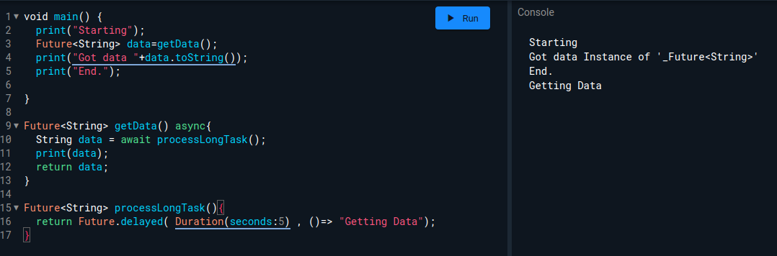
Dart Language
void main() {
print("Starting");
Future<String> data=getData();
print("Got data "+data.toString());
print("End.");
}
Future<String> getData() async{
String data = await processLongTask();
print(data);
return data;
}
Future<String> processLongTask(){
return Future.delayed( Duration(seconds:5) , ()=> "Getting Data");
}
Syntax of Dart : Asynchronous Programming
Asynchronous Programming is a way of writing code that allows a program to do multiple tasks at the same time.
Future represents a value that is not yet available and may be available later.

Slide 29
Dart Language
class Student extends Person {
String? name;
int? age;
int? rollNumber;
static int? totalNumber;
// Constructor
Student(String name, int age, int rollNumber) {
this.name = name;
this.age = age;
this.rollNumber = rollNumber;
}
void show() {
super.show(); // Calling the show method of the parent class
print("local method is called");
}
}
void main() {
Student student = Student("John", 20, 1);
print("Name: ${student.name}");
print("Age: ${student.age}");
print("Roll Number: ${student.rollNumber}");
}
Syntax of Dart : Object Oriented Programming

Slide 30
Dart Language
Syntax of Dart : Exception Handling
try {
int number = int.parse(line);
var result = computeFactorial(number);
print("Result for $number ! is $result");
} catch (e, stacktrace) {
print("Error ${e.toString()} stackTrace $stacktrace ");
}

Slide 31
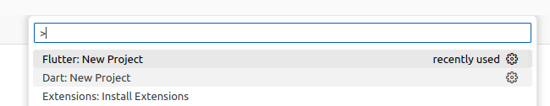
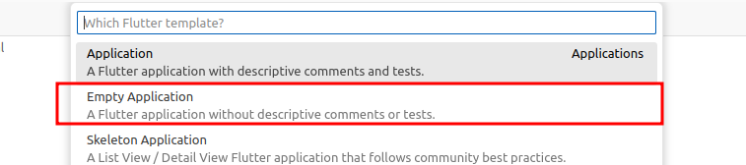
Hello World ! in Flutter
Creating a Simple Hello World !
Create a new Project
Ctrl + Shift + P : Type flutter and choose : New Flutter Project
Choose Empty application

Slide 32
Hello World ! in Flutter
import 'package:flutter/material.dart';
void main() {
runApp(const MainApp());
}
class MainApp extends StatelessWidget {
const MainApp({super.key});
@override
Widget build(BuildContext context) {
return MaterialApp(
home: Scaffold(
appBar: AppBar(title: Text('Hello World App')),
body: Center(
child: Text('Hello World!'),
),
),
);
}
}
main.dart

Slide 33
Hello World ! in Flutter
import 'package:flutter/material.dart';
void main() {
runApp(const MainApp());
}
class MainApp extends StatelessWidget {
const MainApp({super.key});
@override
Widget build(BuildContext context) {
return MaterialApp(
home: Scaffold(
appBar: AppBar(title: Text('Hello World App')),
body: Center(
child: Text('Hello World!'),
),
),
);
}
}
main.dart
Flutter is declarative as opposed to imperative (Kotlin/Java)
object.title=’sss’ ;
object.color=’#FF0000’ ;

Slide 34
Hello World ! in Flutter
Widget(
propertyOne:someData, propertyOne:someData,
child: AnotherWidget…
)

Slide 35
Hello World ! in Flutter
As opposed to Kotlin/Native Android where you have access to the references of all widgets ( R.id.bt_add ..), With Declarative ?

Slide 36
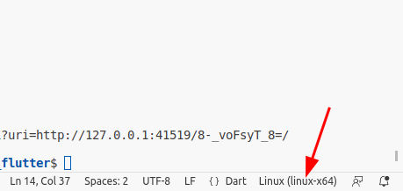
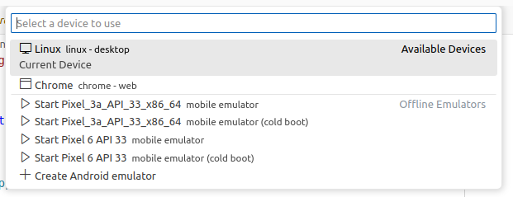
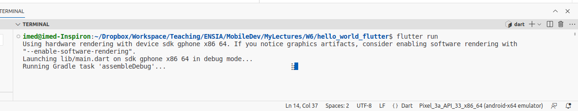
Hello World ! in Flutter
To run
Click on the device at the bottom right corner
Choose an emulator or device
Type in the terminal : flutter run

Slide 37
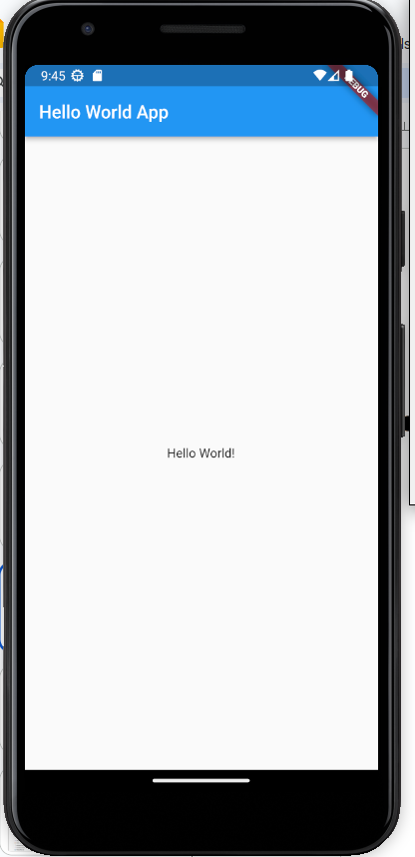
Hello World ! in Flutter
To run
Click on the device at the bottom right corner
Choose an emulator or device
Type in the terminal : flutter run

Slide 38
Hello World ! in Flutter
Hot reload
When you modify the code :
Choose an emulator or device
Type in the terminal : flutter run
Inside the terminal, click the letter “r” to reload the App with the latest changes.

Slide 39
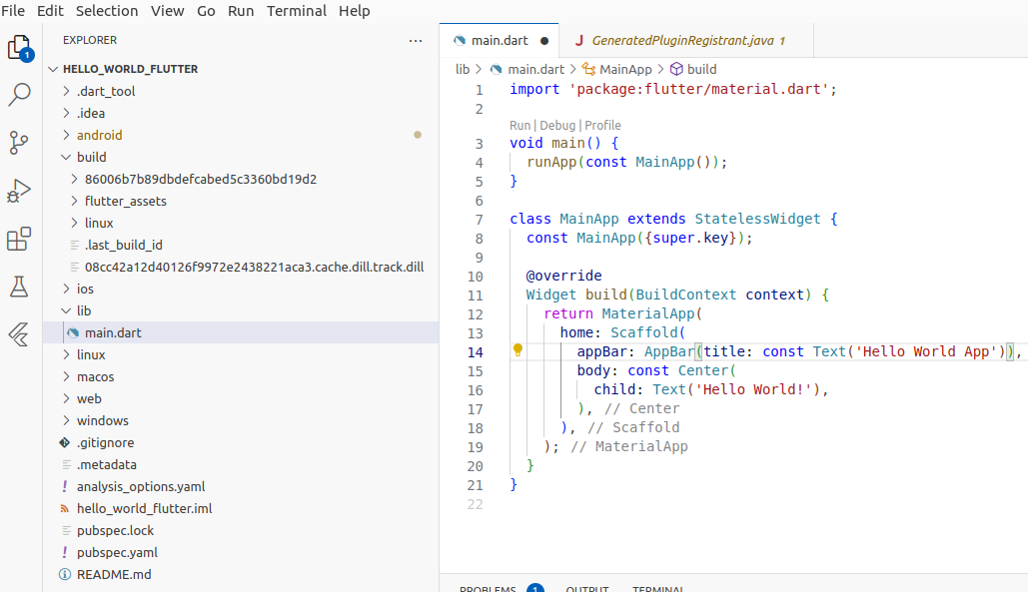
Flutter Project Structure
Creating SharedPreference File
Security and Private of the sharedPreference File :
MODE_PRIVATE ( Default)
MODE_WORLD_READABLE
MODE_WORLD_WRITEABLE
.

Slide 40
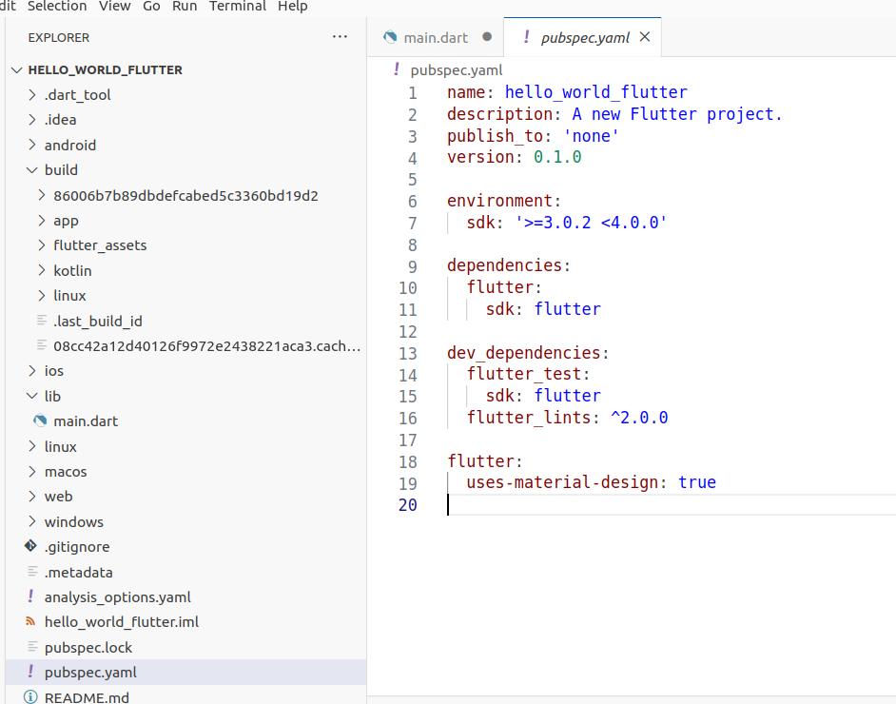
Flutter Project Structure
pubspec.yaml
is a configuration file that is used to define and manage:
Dependencies
Metadata
Settings
Assets ( Images, Fonts…)
YAML : Yet another markup language→later changed to YAML Ain’t Markup Language

Slide 41
Flutter Project Structure
Where to find flutter libraries
Visit https://pub.dev/ and search for whatever feature you want to add :

Slide 42
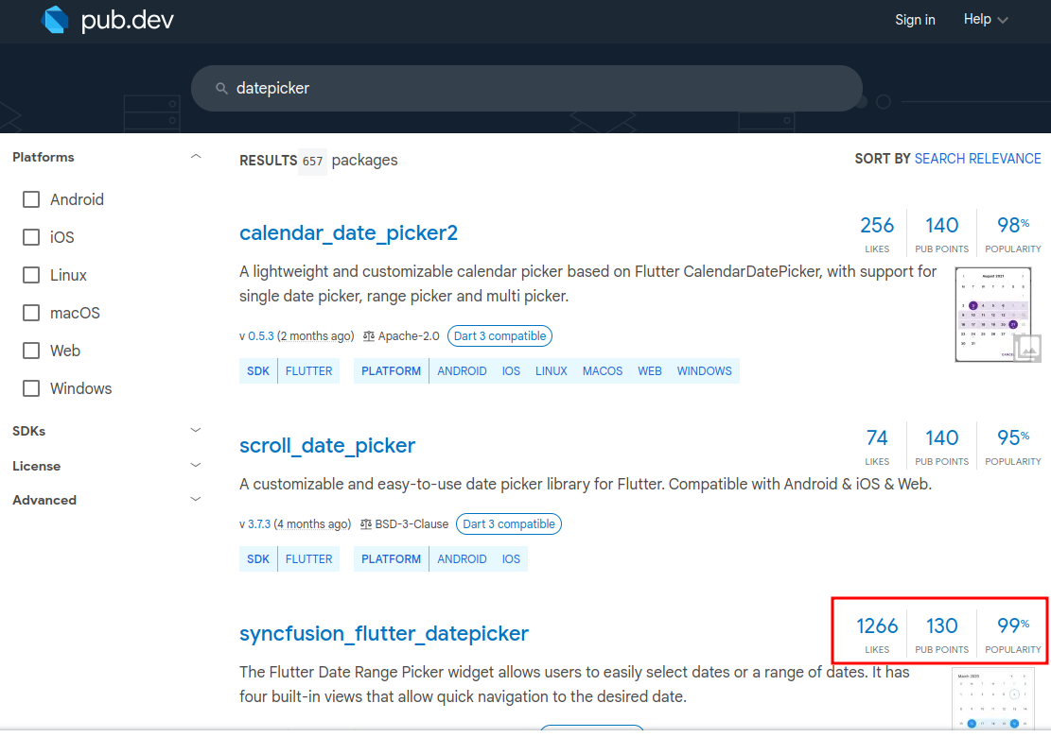
Flutter Project Structure
Where to find flutter libraries

Slide 43
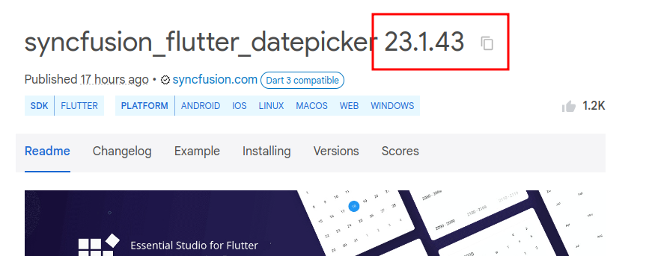
Flutter Project Structure
Version of the libraries:
dependencies:
flutter:
sdk: flutter
cupertino_icons: ^1.0.5
sqflite: ^2.2.8+2
path:
odoo_rpc: ^0.5.1
convert: ^3.1.1
provider: ^6.0.5
flutter_launcher_icons: ^0.13.1
sqflite_common_ffi: any
sqflite_common_ffi_web: any
flutter_barcode_scanner: ^2.0.0
sqlite3_flutter_libs: any
image_picker: ^0.8.7+5
fluttertoast: ^8.2.2
The ^ sign ( Caret Syntax) = Any version guaranteed to be backwards compatible with the specified version.

Slide 44
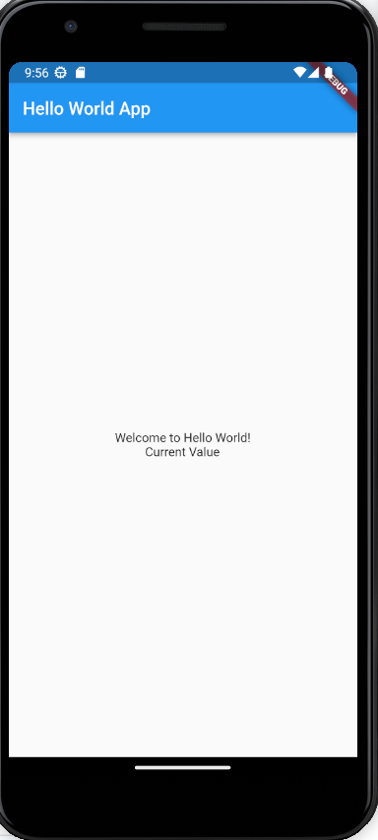
Widgets for Building UIs
Texts vertically aligned , one line at a row:
@override
Widget build(BuildContext context) {
return MaterialApp(
home: Scaffold(
appBar: AppBar(title: const Text('Hello World App')),
body: const Center(
child: Column(
mainAxisAlignment: MainAxisAlignment.center,
crossAxisAlignment: CrossAxisAlignment.center,
children: [
Text('Welcome to Hello World!'),
Text('Current Value'),
]),
),
),
);
}

Slide 45
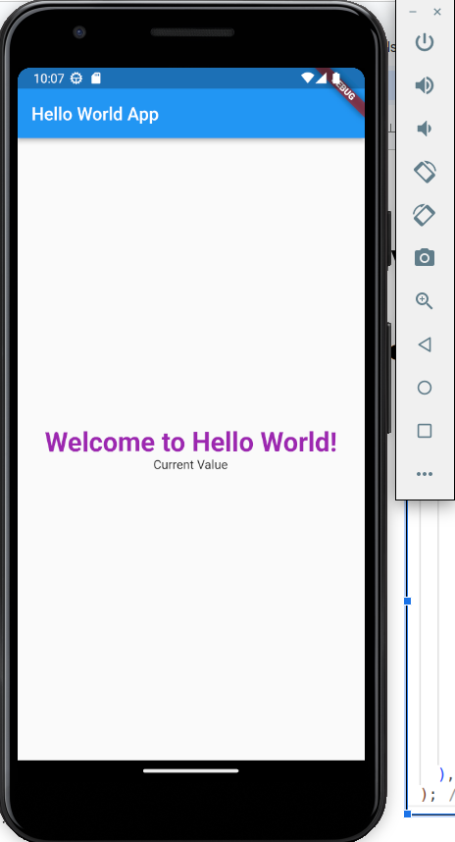
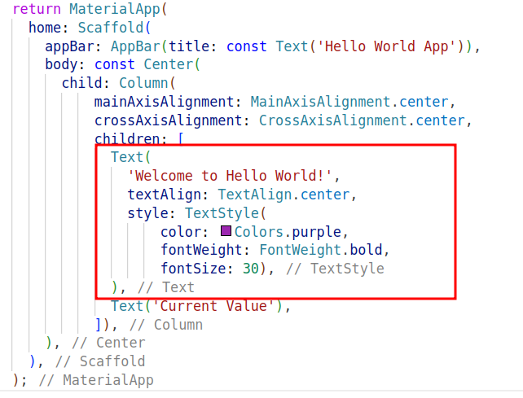
Widgets for Building UIs
Styling Text

Slide 46
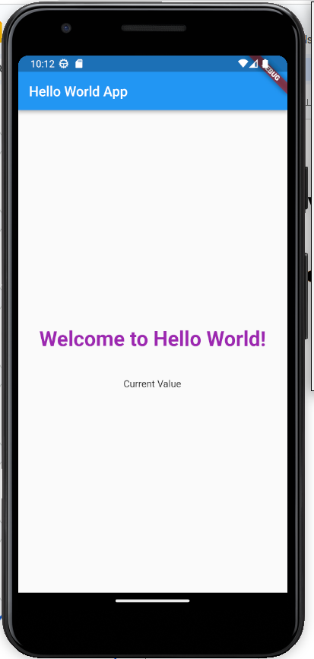
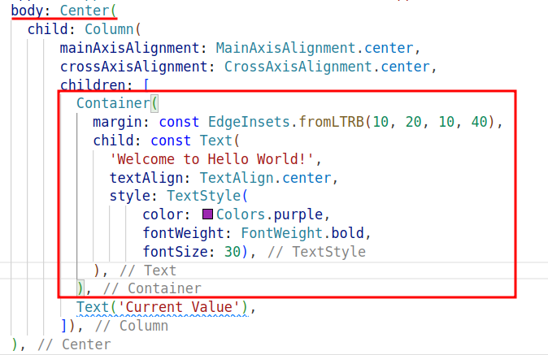
Widgets for Building UIs
Putting a Widget inside a Container + Margin
Container has attributes : child + margin ( NOT children )

Slide 47
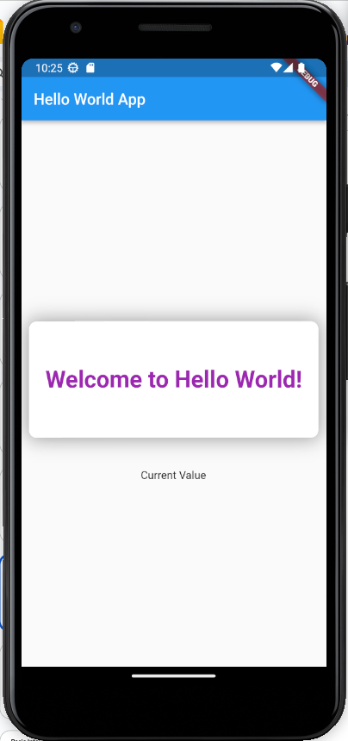
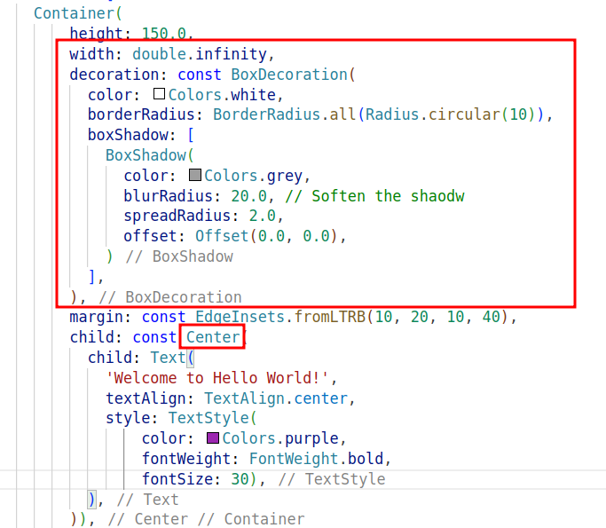
Widgets for Building UIs
Creating a nice rounded box with shadow

Slide 48
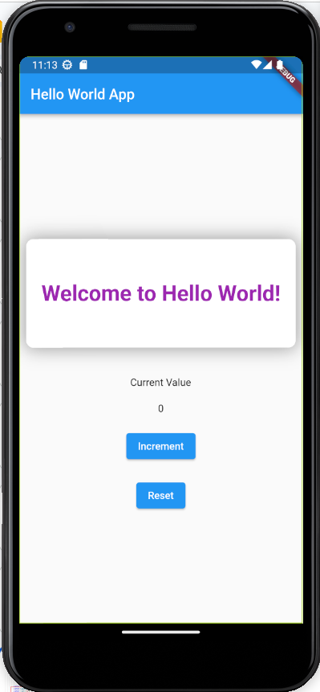
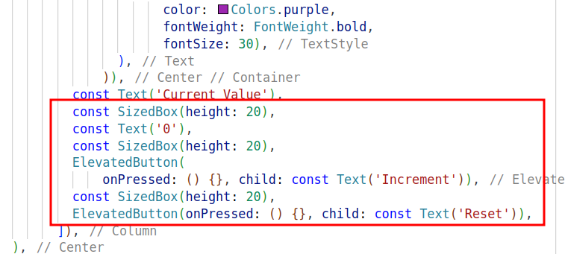
Widgets for Building UIs
Adding some Widgets : Text and Button

Slide 49
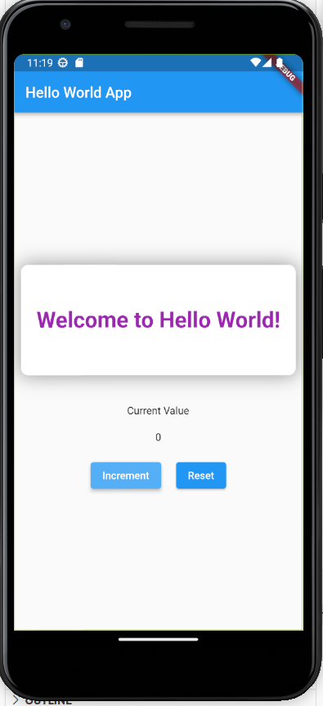
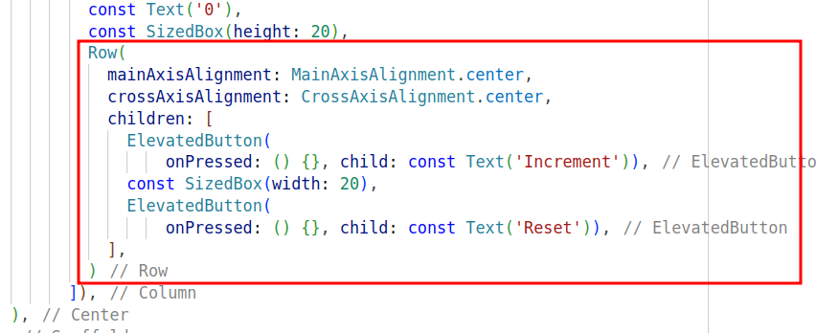
Widgets for Building UIs
Adding Buttons horizontally aligned

Slide 50
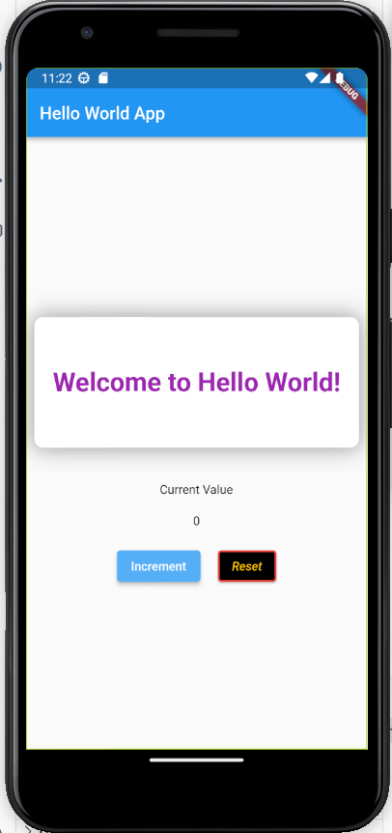
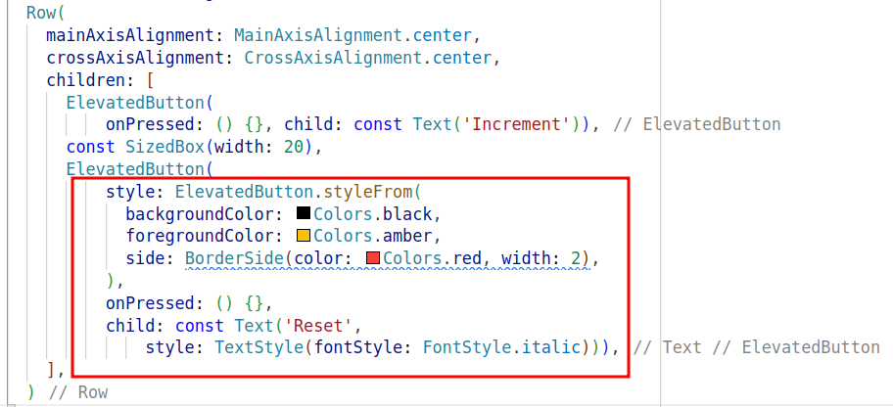
Widgets for Building UIs
Styling for a Button

Slide 51
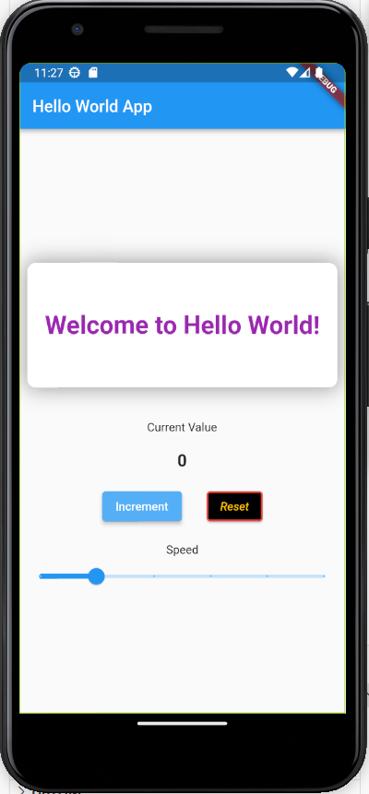
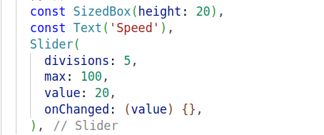
Widgets for Building UIs
Adding a Slider

Slide 52
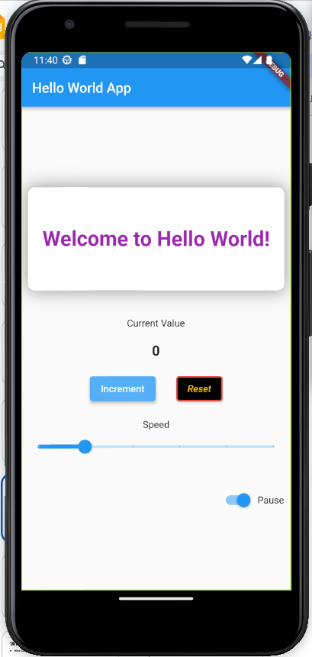
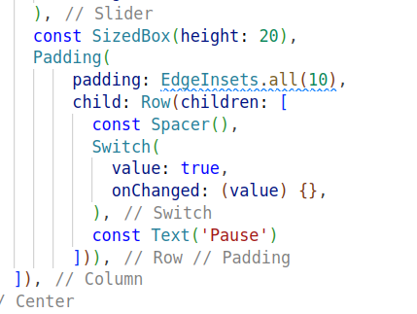
Widgets for Building UIs
Adding a Switch : Toggle Button

Slide 53
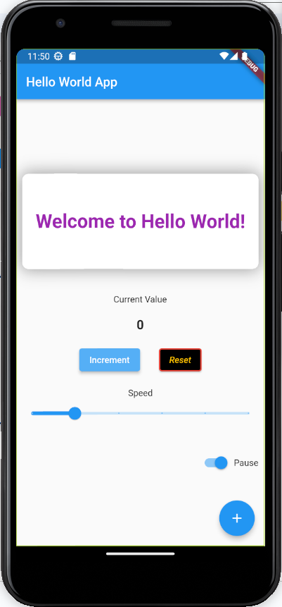
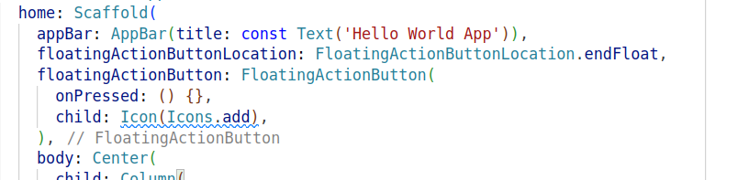
Widgets for Building UIs
Adding a floating Button

Slide 54
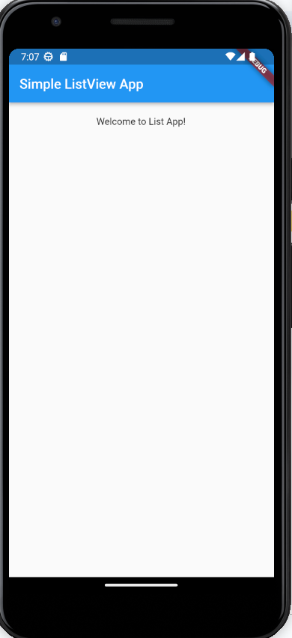
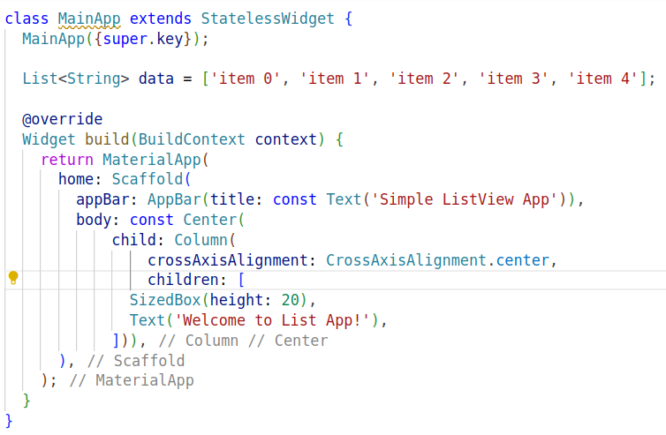
Widgets for Building UIs
List View using Flutter

Slide 55
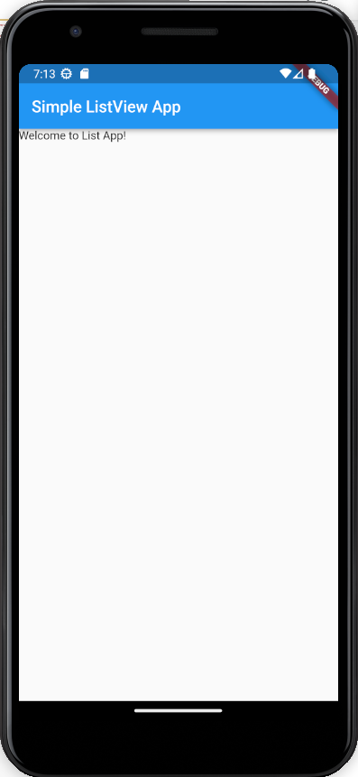
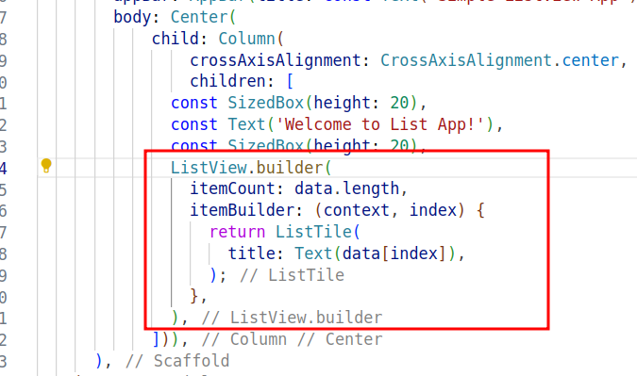
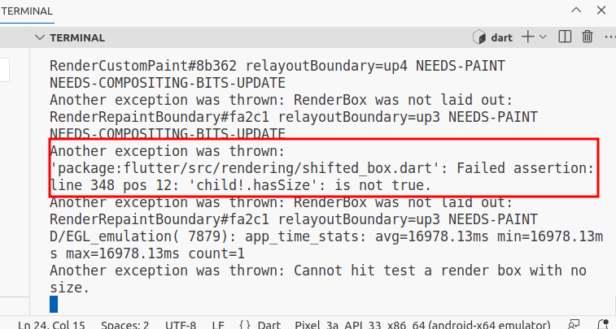
Widgets for Building UIs
List View using Flutter

Slide 56
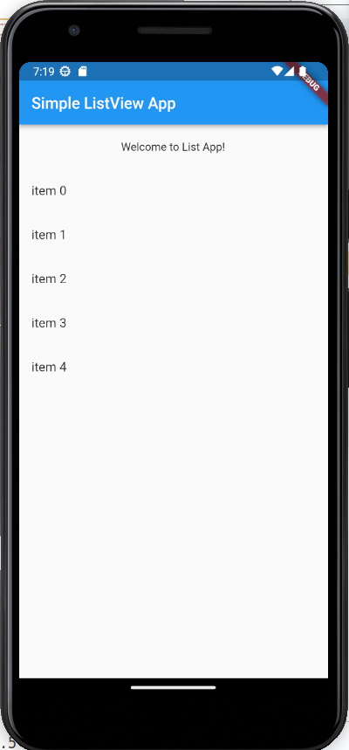
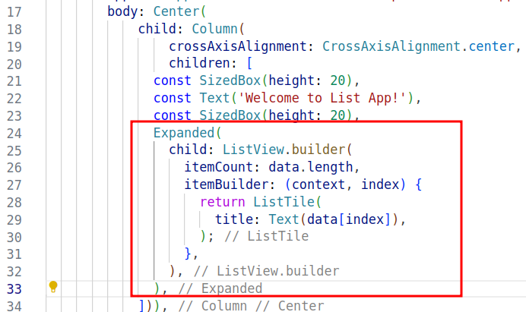
Widgets for Building UIs
List View using Flutter

Slide 57
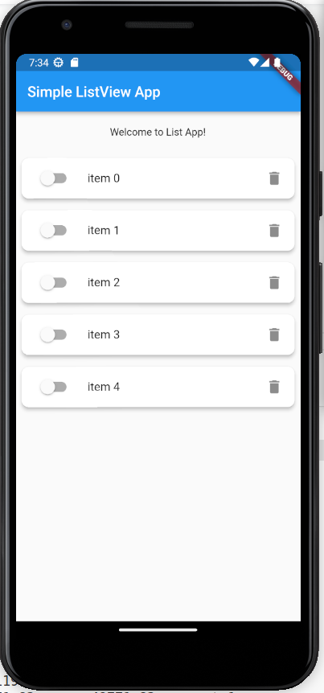
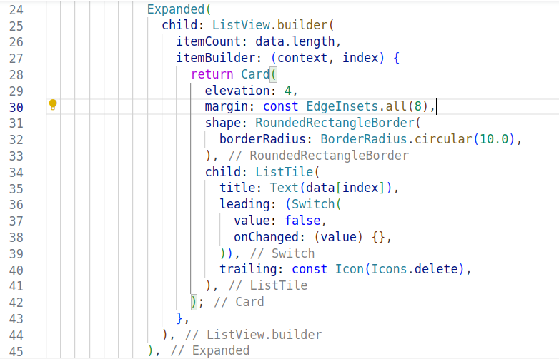
Widgets for Building UIs
Customizing the List View using Flutter

Slide 58
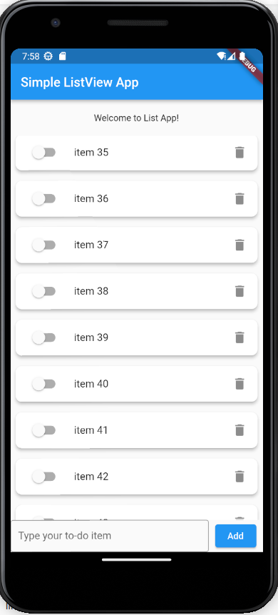
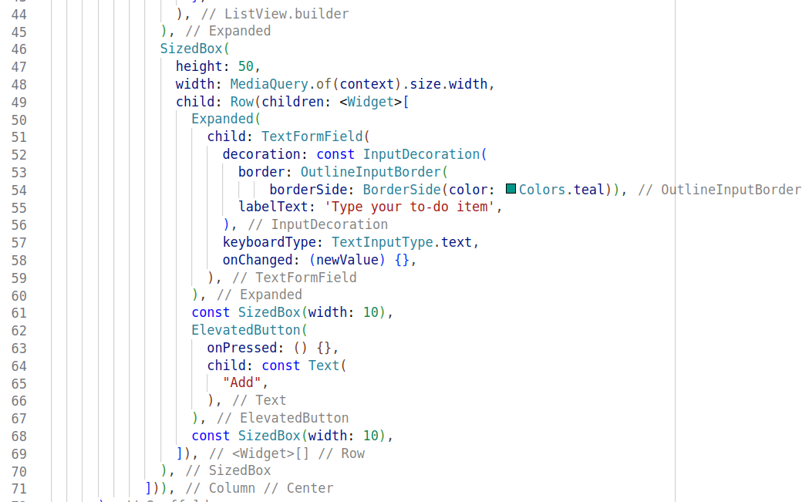
Widgets for Building UIs
Fixed Bar at the bottom

Slide 59
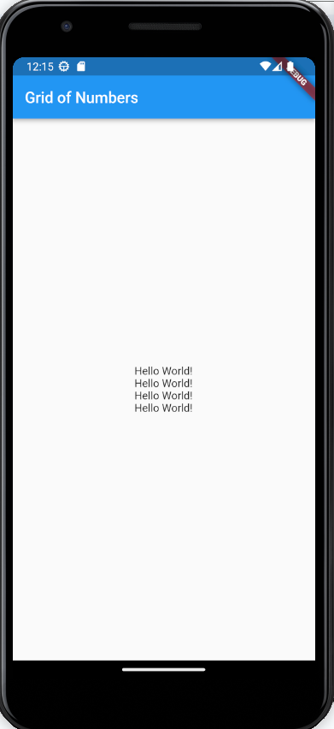
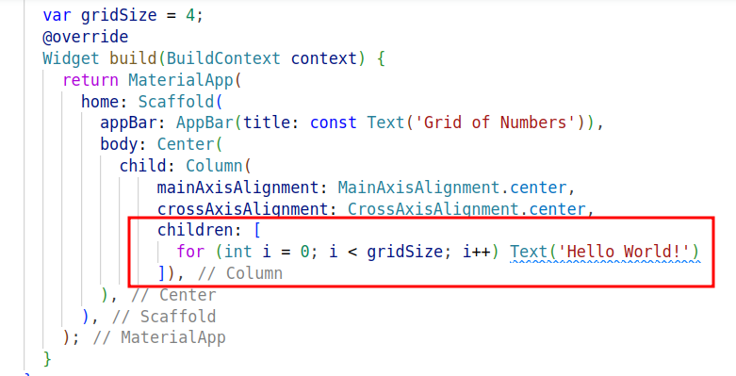
Widgets for Building UIs
Creating via Loops and IFs
Only single line statement are allowed for for or if = no { }

Slide 60

Widgets for Building UIs
How to add an Image as a background
Create assets/images
Upload your image there

Slide 61

Widgets for Building UIs
How to add an Image as a background
Upload pubspec.yaml file

Slide 62


Widgets for Building UIs
How to add an Image as a background

Slide 63

Widgets for Building UIs
Encapsulating Widgets as Functions

Slide 64


Widgets for Building UIs
Encapsulating Widgets as Functions

Slide 65


Widgets for Building UIs
How to make a numbered Grid :
You can even use the GridView Widget

Slide 66


Widgets for Building UIs
How to make a numbered Grid : : Last Cell Empty

Slide 67
Widgets for Building UIs
Learn more on other widgets:
https://gallery.flutter.dev/

Slide 68
Stateless & Stateful Widgets for Flutter
Stateless Widget :
Once it is created and drawn on the screen, they will never change
Better suited for static user interfaces.

Slide 69


Stateless & Stateful Widgets for Flutter
import 'package:flutter/material.dart';
class MyExampleStatelessWidget extends StatelessWidget {
final String text;
const MyExampleStatelessWidget(this.text);
@override
Widget build(BuildContext context) {
return Container(
width: double.infinity,
child: Card(
elevation: 4,
margin: const EdgeInsets.all(8),
child: Padding(
padding: EdgeInsets.all(10),
child: Text(text)
)
)
);
}
}
Stateless Widget :
Once it is created and drawn on the screen, they will never change
Better suited for static user interfaces.

Slide 70
Stateless & Stateful Widgets for Flutter
Stateful Widget :
They can change based on the interaction with the user. (i,e they are mutable)

Slide 71


Stateless & Stateful Widgets for Flutter
import 'package:flutter/material.dart';
class MyStatefulExample extends StatefulWidget {
@override
_MyStatefulExampleState createState() => _MyStatefulExampleState();
}
class _MyStatefulExampleState extends State<MyStatefulExample> {
int _counter = 0;
@override
Widget build(BuildContext context) {
return Column(
children: <Widget>[
SizedBox(height: 100),
Text('Counter: $_counter'),
ElevatedButton(
onPressed: () {
setState(() {
_counter = _counter + 1;
});
},
child: Text('Increment'),
),
],
);
}
}
Stateful Widget :
They can change based on the interaction with the user. I,e they are mutable

Slide 72
Hello World ! in Flutter
As opposed to Kotlin/Native Android where you have access to the references of all widgets ( R.id.bt_add ..), With Declarative ?

Slide 73
Hello World ! in Flutter
You create variables, data collections, objects and you attach them to widgets,
Later, You change the data or variable values and you setState to refresh the screen

Slide 74
Section 2
Demo Apps in Flutter

Slide 75


Incrementing App in Flutter

Slide 76


To-Do App ( No DB)

Slide 77

To-Do App ( No DB)

Slide 78

To-Do App ( No DB)

Slide 79

To-Do App ( No DB)

Slide 80
Constructing UIs for Flutter Apps
Scaffold : appBar, body, floatingActionButton, drawer, bottomNavigationBar
AppBar : title , leading, elevation
Container : child, padding, margin, height, width,decoration alignment
Column : children, mainAxisAlignment, crossAxisAlignment
Row : children, mainAxisAlignment, crossAxisAlignment
Stack : alignment, children,
SizedBox : child ,height, width ,
Card : child, color, elevation, margin, clipBehavior, shape
Expanded : child, flex
Spacer : flex
Padding : padding --> EdgeInsets.all|only|fromLTRB|symmetric
Center : child
Align : child,alignment
ListView.builder :scrollDirection, physics, itemCount, itemBuilder(context,index)
GridView.builder : padding, physics, itemCount, itemBuilder(context,index)
Text : style, textAlign
TextFormField :onChanged, controller, decoration, validator
ElevatedButton :style, onPressed, child
IconButton : icon, onPressed
Icon : color, size,
Slider :value, max, divisions, onChanged, label
Switch :value, onChanged, thumbIcon
ListTile : leading, title, subtitle, trailing, tileColor, onTap
Image.asset : imagepath,
TextStyle : fontSize, color, fontWeigth
BoxDecoration : image, shape, border, borderRaduis, color
Opacity : opacity, child
RoundedRectangleBorder :borderRadius, side
Position : left, bottom, right, top
BoxShadow : color, offset, blurStyle

Slide 81
Lecture Demo Apps
Compute Factorial in Dart
https://www.dropbox.com/scl/fo/4scdnwyub1bx8on2k2zn9/h?rlkey=2mt4k04lulngz1bqop6mj3tmo&dl=0
Hello World App : Using Widgets.
https://www.dropbox.com/scl/fo/3ug0k10vz906xfnwse5bl/h?rlkey=q7a2umvmy6vpkjwqqniu55cxz&dl=0
To-Do UI with a ListView
https://www.dropbox.com/scl/fo/tiwsim8y10wl71i1ip4lo/h?rlkey=y7irpo6f61vbtuubybi7ghsh2&dl=0
Stateless Widget Example
https://www.dropbox.com/scl/fo/k4q0g74b8dwpb16amctnj/h?rlkey=olxwsx7dihxe3cfcn4m85gwnj&dl=0
Stateful Widget Example
https://www.dropbox.com/scl/fo/o07enhjv74v5890ivg2n8/h?rlkey=qoiwer5htvgh575ozpvok8cj6&dl=0
Incrementing App
https://www.dropbox.com/scl/fo/9jtef5wr9yiskze215yc8/h?rlkey=176pv6kep1w2wgc8cvldvg9zl&dl=0
Interactive To-Do App
https://www.dropbox.com/scl/fo/o84pyfe0m98gnay5mlynz/h?rlkey=3g3x64pnq61rt4u5e31x3drpl&dl=0

Slide 82
Resources
https://m3.material.io/
https://codelabs.developers.google.com/codelabs/flutter-codelab-first#0
https://codewithandrea.com/tutorials/
https://www.youtube.com/watch?v=cCMULezpNRQ
https://www.youtube.com/watch?v=L9cP9OTUstA&list=PLjxrf2q8roU23XGwz3Km7sQZFTdB996iG
https://www.youtube.com/watch?v=OBIuSrg_Quo&list=PLjxrf2q8roU1fRV40Ec8200rX6OuQkmnl
https://www.youtube.com/watch?v=fQldtPigGBM&list=PLjxrf2q8roU3N8-rlgg8_jueoNT-85A6_
https://gallery.flutter.dev/#/
https://dart-tutorial.com/introduction-and-basics/
https://yaz.in/assets/flutter/Flutter%20Cheat%20Sheet.pdf

